Slide 1
Market Power: Monopoly
Ref. Pindyck and Rubinfeld

Slide 2
● monopoly Market with only one seller.
● market power Ability of a seller or buyer to affect the price of a good.
What a monopolist can choose?
Price (uniform or discriminating) or output
Quality/durability
R&D
Advertisement

Slide 3
Uniform pricing rule of a monopolist
The monopolist cannot set both p & q independently.
Max π = pq-c(q) Subject to q = q(p)
P
Max π = pq(p)-c[q(p)]
P
Alternatively:
Max π = pq-c(q) Subject to p = p(q)
q
Max π = p(q)q-c(q)
q
Let p*= argmax π = pq(p)-c[q(p)]
Similarly, q*= argmax π = p(q)q-c(q)
Solution:
q* = q(p*)
p* = p(q*)

Slide 4
P
p₀
q₀
q
D
q

Slide 5
p
If he chooses this price , he will incur loss
q₀
q
q

Slide 6
Let the monopolist chooses quantity.
Max π = p(q)q-c(q)
q
FOC: R’(q)=C’(q)
SOC: R”(q)<C”(q)
Difference between perfect competition and monopoly:
Equilibrium can occur even at the falling part of MC.
P_{m}= AR(q_{m})> MR (q_{m})=C’(q_{m})=> P_{m}> C’(q_{m}) => πm>0

Slide 7
MC
e
P_{m}
q_{m}
D
MC < MR
MR

Slide 8

Average Revenue and Marginal Revenue
● marginal revenue Change in revenue resulting from a one-unit increase in output.
To see the relationship among total, average, and marginal revenue, consider a firm facing the following demand curve:
P = 6 – Q
TABLE 1 Total, Marginal, and Average Revenue
Total Marginal Average
Price (P) Quantity (Q) Revenue (R) Revenue (MR) Revenue (AR)
$6 0 $0 --- ---
5 1 5 $5 $5
4 2 8 3 4
3 3 9 1 3
2 4 8 -1 2
1 5 5 -3 1

Slide 9

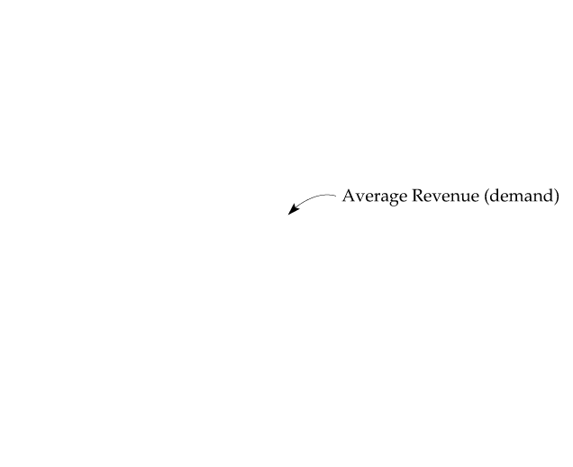

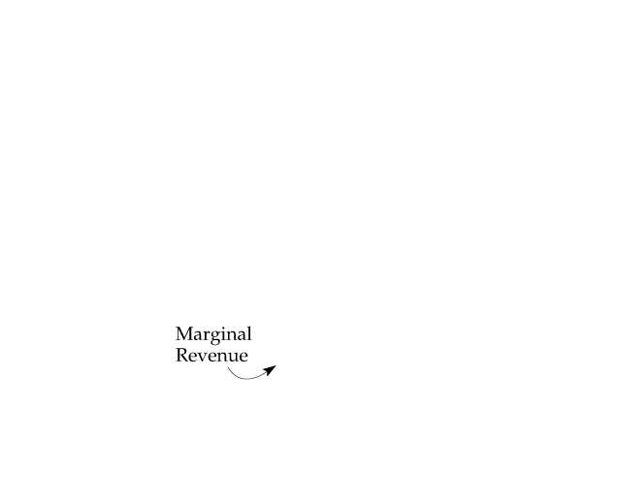
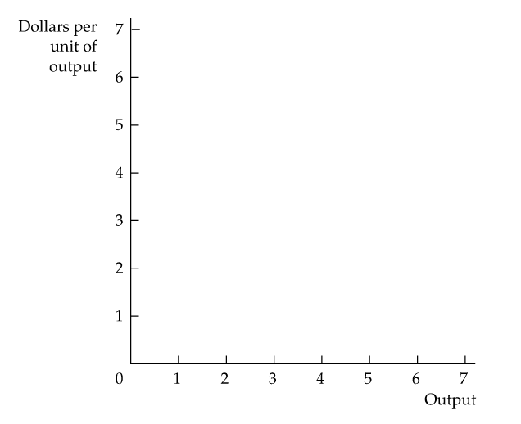
Average and Marginal Revenue
Average and marginal revenue are shown for the demand curve P = 6 − Q.

Slide 10

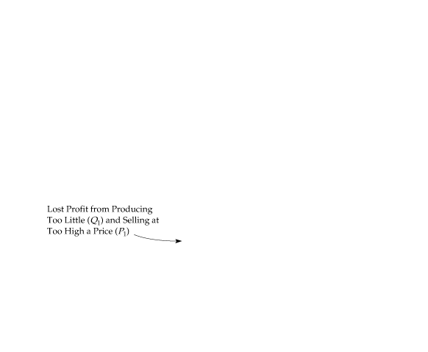

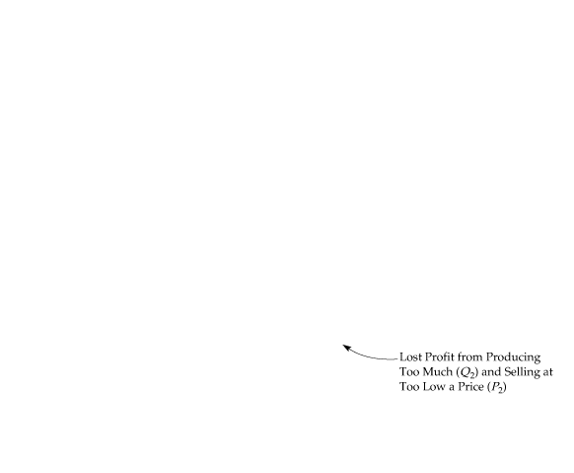
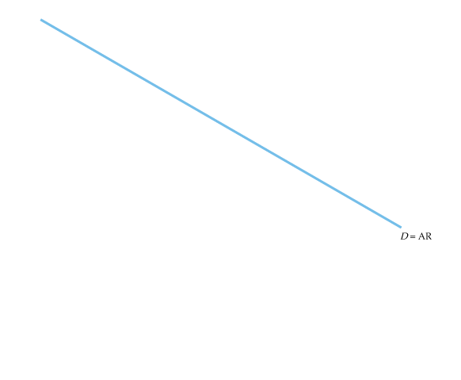
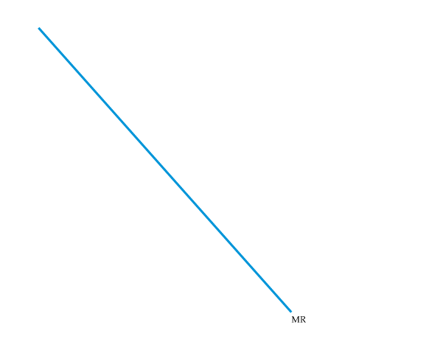
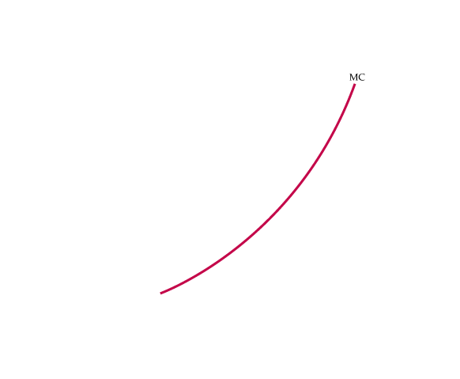
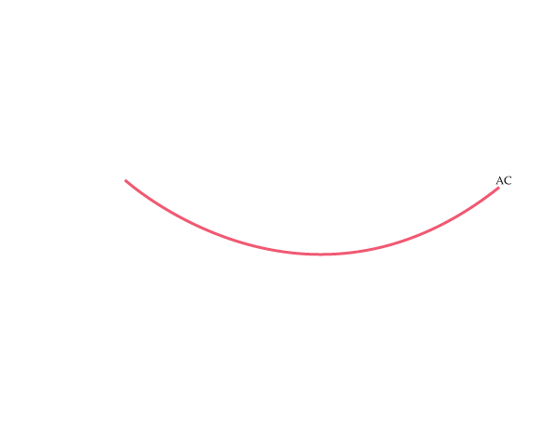
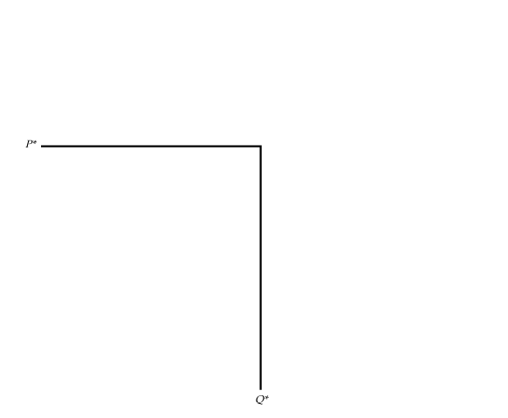
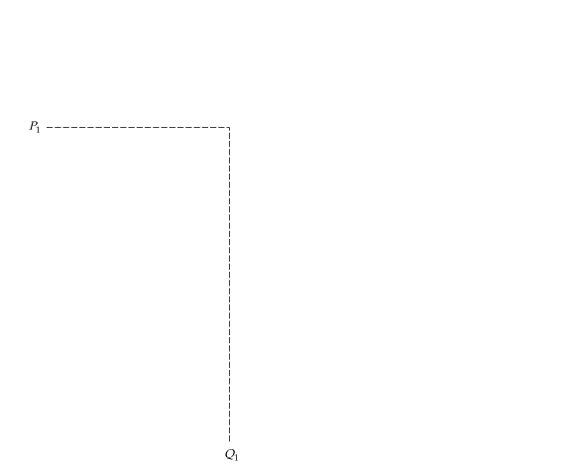
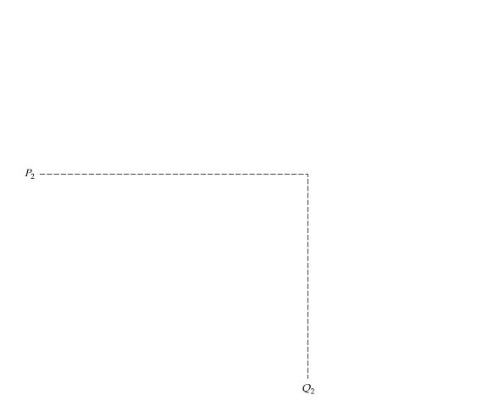
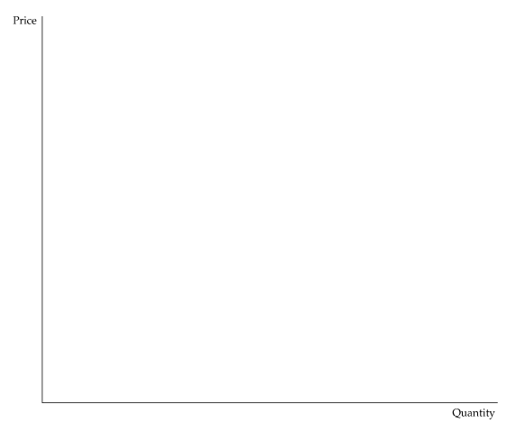

The Monopolist’s Output Decision
Profit Is Maximized When Marginal Revenue Equals Marginal Cost
Q* is the output level at which MR = MC.
If the firm produces a smaller output—say, Q₁—it sacrifices some profit because the extra revenue that could be earned from producing and selling the units between Q₁ and Q* exceeds the cost of producing them.
Similarly, expanding output from Q* to Q₂ would reduce profit because the additional cost would exceed the additional revenue.

Slide 11

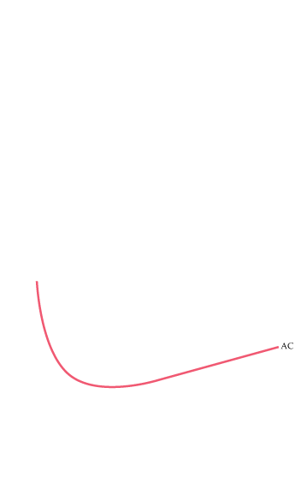

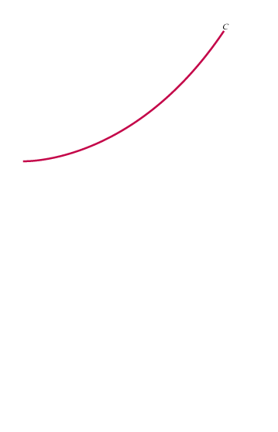

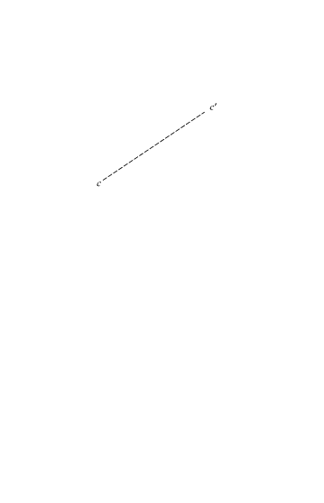
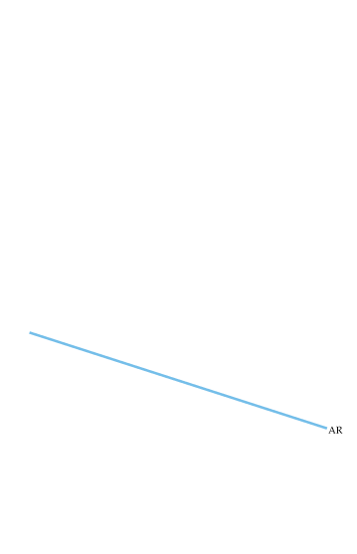
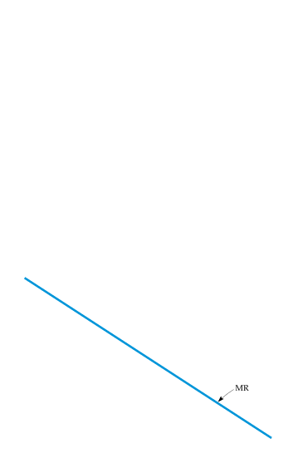
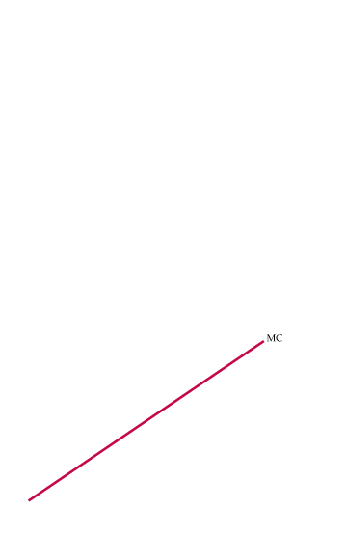
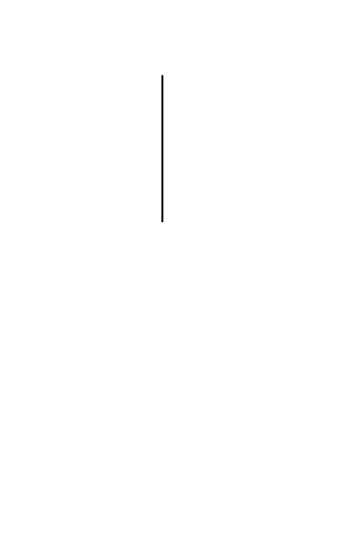
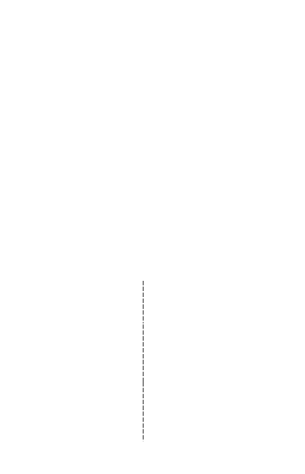



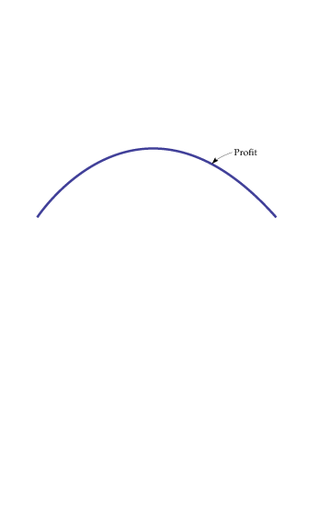

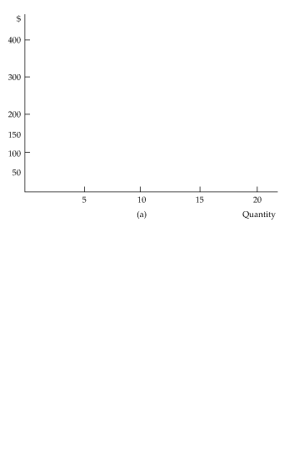
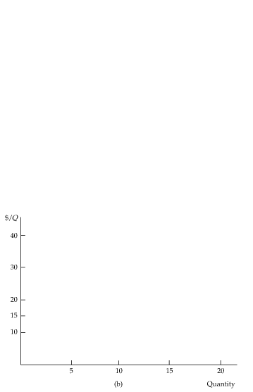
Profit Maximization
An Example
Part (a) shows total revenue R, total cost C, and profit, the difference between the two.
Part (b) shows average and marginal revenue and average and marginal cost.
Marginal revenue is the slope of the total revenue curve, and marginal cost is the slope of the total cost curve.
The profit-maximizing output is Q* = 10, the point where marginal revenue equals marginal cost.
At this output level, the slope of the profit curve is zero, and the slopes of the total revenue and total cost curves are equal.
The profit per unit is $15, the difference between average revenue and average cost. Because 10 units are produced, total profit is $150.

Slide 12

Monopoly power:
● Lerner Index of Monopoly Power Measure of monopoly power calculated as excess of price over marginal cost as a fraction of price.
Max π = p(q)q-c(q)
q
FOC:
For the competitive firm, price equals marginal cost;
For a monopoly, price exceeds marginal cost.
Relative price margin/relative mark up

Slide 13
Implication:
As long as e_{p} < ∞ => p > c’(q_{m}) => profit >0 (supernormal profit);
Lerner Index of monopoly power varies inversely with e_{p};
As long as MC > 0, at monopolist’s equilibrium demand is price elastic.

Slide 14
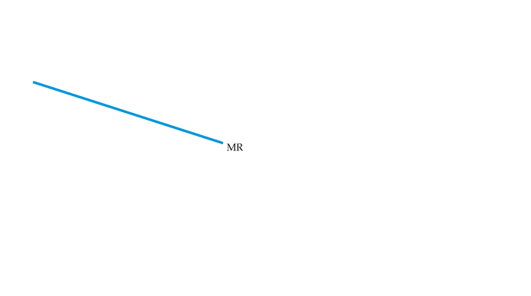

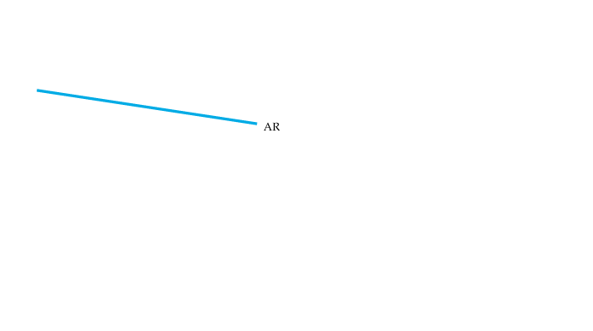
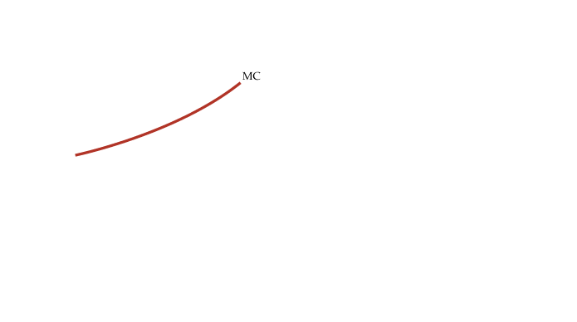
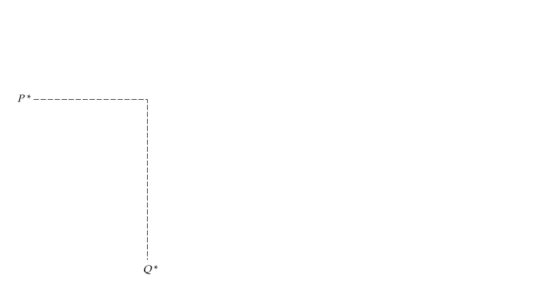

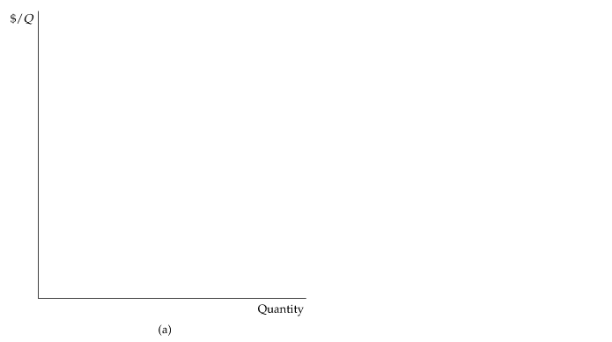
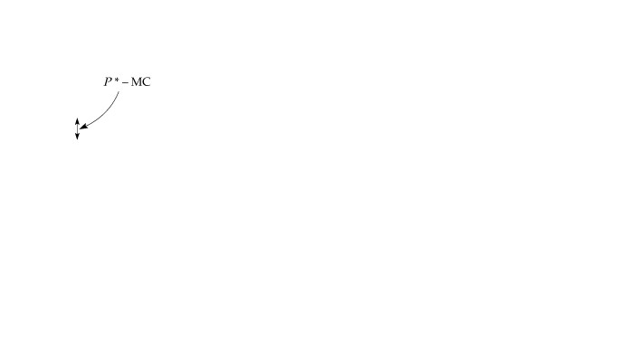
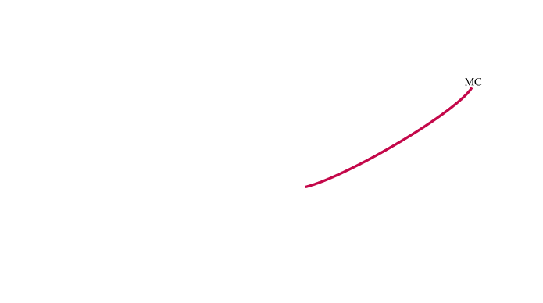
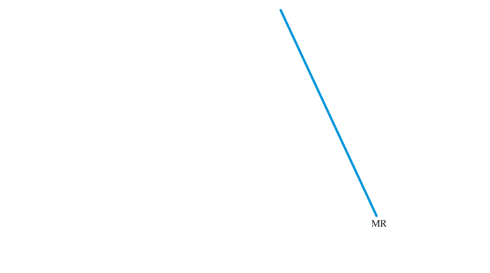
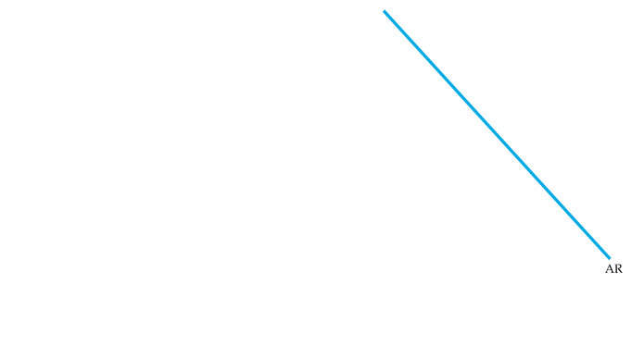
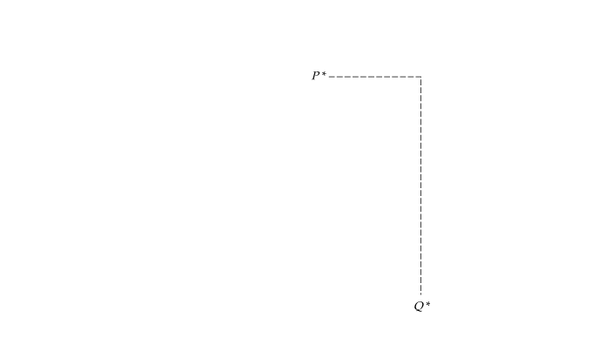


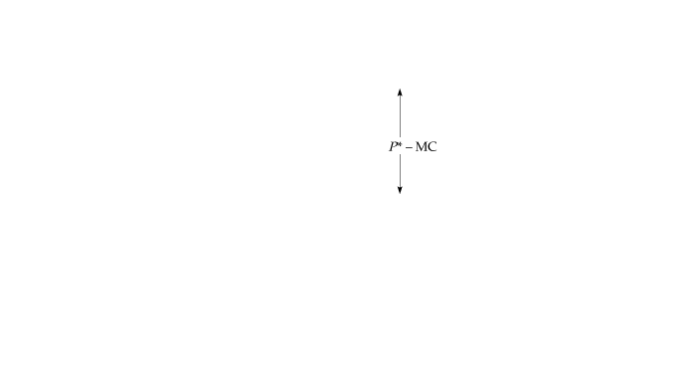
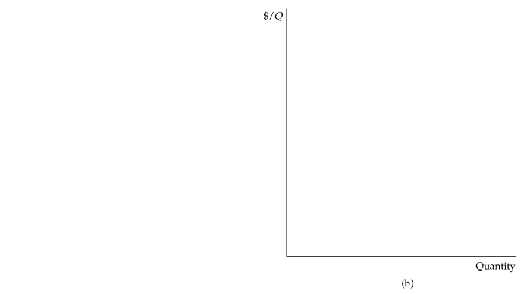
Elasticity of Demand and Price Markup
The markup (P − MC)/P is equal to minus the inverse of the elasticity of demand facing the firm.
If the firm’s demand is elastic, as in (a), the markup is small and the firm has little monopoly power.
The opposite is true if demand is relatively inelastic, as in (b).

Slide 15
If monopolist chooses price
Max π = pq(p)-c[q(p)]
P

Slide 16
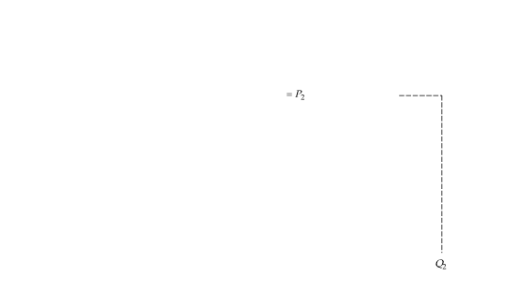
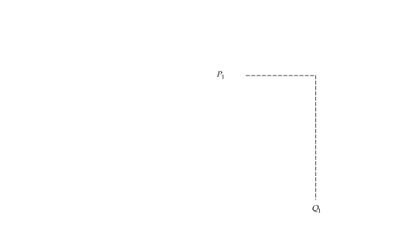
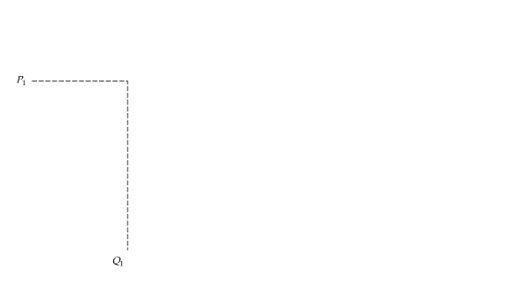
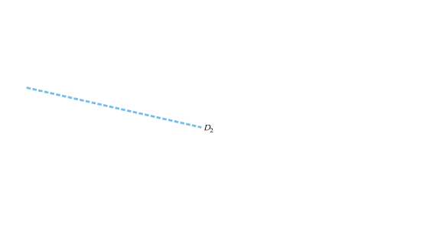
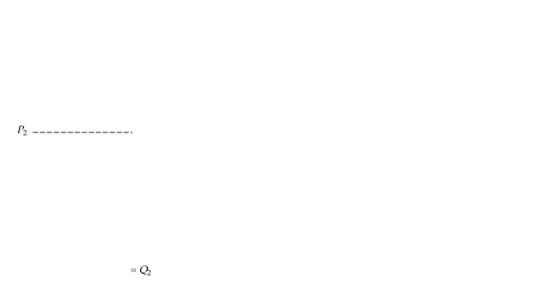
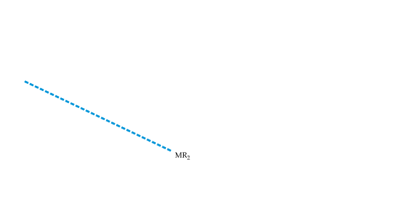
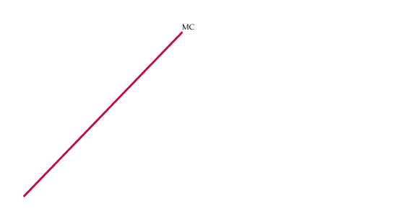
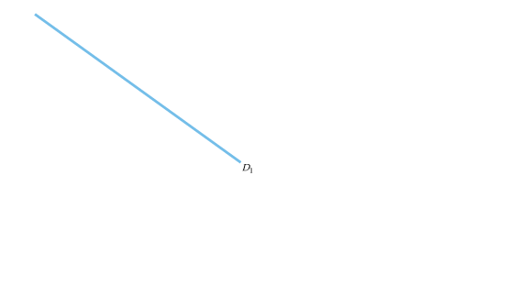
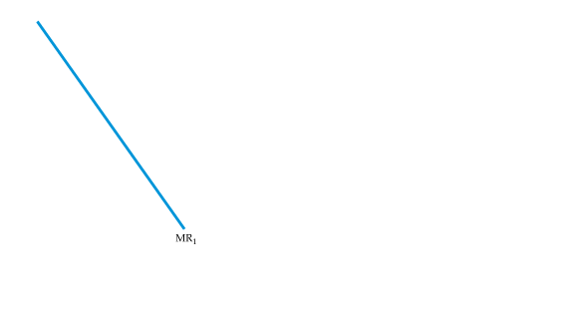

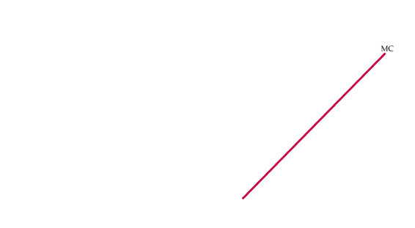
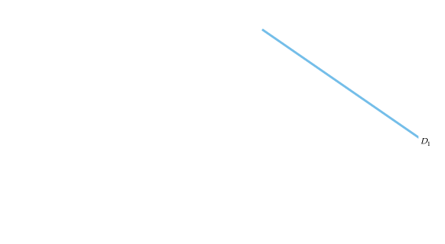
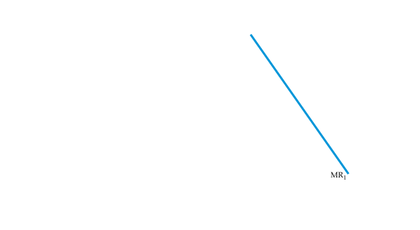


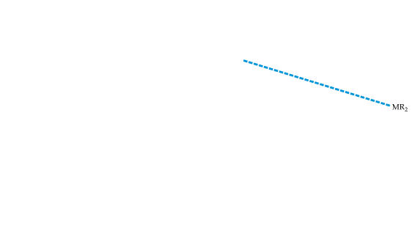

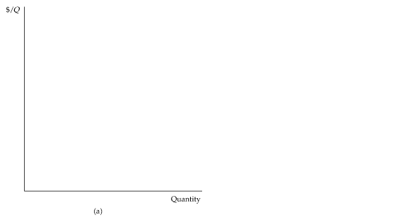

Supply curve of a MONOPOLY…Does it exist? Answer is No
Shifts in Demand
Shifting the demand curve shows that a monopolistic market has no supply curve—i.e., there is no one-to-one relationship between price and quantity produced.
In (a), the demand curve D₁ shifts to new demand curve D₂.
But the new marginal revenue curve MR₂ intersects marginal cost at the same point as the old marginal revenue curve MR₁.
The profit-maximizing output therefore remains the same, although price falls from P₁ to P₂.
In (b), the new marginal revenue curve MR₂ intersects marginal cost at a higher output level Q₂.
But because demand is now more elastic, price remains the same.

Slide 17











Effect of Tax
Suppose a specific tax of t dollars per unit is levied, so that the monopolist must remit t dollars to the government for every unit it sells. If MC was the firm’s original marginal cost, its optimal production decision is now given by
Effect of Excise Tax on Monopolist
With a tax t per unit, the firm’s effective marginal cost is increased by the amount t to MC + t.
In this example, the increase in price ΔP is larger than the tax t.

Slide 18
The Multiplant Firm
Suppose a firm has two plants. What should its total output be, and how much of that output should each plant produce? We can find the answer intuitively in two steps.
● Step 1. Whatever the total output, it should be divided between the two plants so that marginal cost is the same in each plant. Otherwise, the firm could reduce its costs and increase its profit by reallocating production.
● Step 2. We know that total output must be such that marginal revenue equals marginal cost. Otherwise, the firm could increase its profit by raising or lowering total output.

Slide 19


The Multiplant Firm
We can also derive this result algebraically. Let Q₁ and C₁ be the output and cost of production for Plant 1, Q₂ and C₂ be the output and cost of production for Plant 2, and Q_{T} = Q₁ + Q₂ be total output. Then profit is
The firm should increase output from each plant until the incremental profit from the last unit produced is zero. Start by setting incremental profit from output at Plant 1 to zero:
Here Δ(PQ_{T})/ΔQ₁ is the revenue from producing and selling one more unit—i.e., marginal revenue, MR, for all of the firm’s output.

Slide 20



The Multiplant Firm
The next term, ΔC₁/ΔQ₁, is marginal cost at Plant 1, MC₁. We thus have MR − MC₁ = 0, or
Similarly, we can set incremental profit from output at Plant 2 to zero,
Putting these relations together, we see that the firm should produce so that
(3)

Slide 21











Production with Two Plants
A firm with two plants maximizes profits by choosing output levels Q₁ and Q₂ so that marginal revenue MR (which depends on total output) equals marginal costs for each plant, MC₁ and MC₂.

Slide 22













THE SOCIAL COSTS OF MONOPOLY POWER
Deadweight Loss from Monopoly Power
The shaded rectangle and triangles show changes in consumer and producer surplus when moving from competitive price and quantity, P_{c} and Q_{c},
to a monopolist’s price and quantity, P_{m} and Q_{m}.
Because of the higher price, consumers lose A + B
and producer gains A − C. The deadweight loss is B + C.

Slide 23















Price Regulation in Monopoly
Price Regulation
When price is lowered to P_{c}, at the point where marginal cost intersects average revenue, output increases to its maximum Q_{c}. This is the output that would be produced by a competitive industry.
Lowering price further, to P₃ reduces output to Q₃ and causes a shortage, Q’₃ − Q₃.

Slide 24











Natural Monopoly
Firm that can produce the entire output of the market at a cost lower than what it would be if there were several firms.
Regulating the Price of a Natural Monopoly
A firm is a natural monopoly because it has economies of scale (declining average and marginal costs) over its entire output range.
If price were regulated to be P_{c} the firm would lose money and go out of business.
Setting the price at P_{r} yields the largest possible output consistent with the firm’s remaining in business; excess profit is zero.

